Slide 1
Restricting and Sorting Data
2

Slide 2
Objectives
After completing this lesson, you should be able to do the following:
Limit the rows that are retrieved by a query
Sort the rows that are retrieved by a query
Use ampersand substitution to restrict and sort output at run time

Slide 3
Lesson Agenda
Limiting rows with:
The WHERE clause
The comparison conditions using =, <=, BETWEEN, IN, LIKE, and NULL conditions
Logical conditions using AND, OR, and NOT operators
Rules of precedence for operators in an expression
Sorting rows using the ORDER BY clause
Substitution variables
DEFINE and VERIFY commands

Slide 4
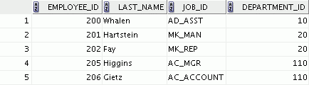

Limiting Rows Using a Selection
EMPLOYEES
…
“retrieve all employees in department 90”

Slide 5
Limiting the Rows
Restrict the rows that are returned by using the WHERE
clause:
SELECT *|{[DISTINCT] column|expression [alias],...} FROM table
[WHERE condition(s)];
The WHERE clause follows the FROM clause.

Slide 6
Using the WHERE Clause
SELECT employee_id, last_name, job_id, department_id FROM employees
WHERE department_id = 90 ;

Slide 7
Character Strings and Dates
Character strings and date values are enclosed with single quotation marks.
Character values are case-sensitive and date values are format-sensitive.
The default date display format is DD-MON-RR.
SELECT last_name, job_id, department_id FROM employees
WHERE last_name =
'Whalen'
SELECT last_name FROM employees
WHERE hire_date = | '17-FEB-96' | ;

Slide 8
Comparison Operators
Operator | Meaning
= | Equal to
> | Greater than
>= | Greater than or equal to
< | Less than
<= | Less than or equal to
<> | Not equal to
BETWEEN ...AND... | Between two values (inclusive)
IN(set) | Match any of a list of values
LIKE | Match a character pattern
IS NULL | Is a null value

Slide 9

Using Comparison Operators
SELECT last_name, salary FROM employees
WHERE salary <=3000 ;
<= 3000

Slide 10
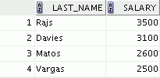
Range Conditions Using the BETWEEN Operator
Use the BETWEEN operator to display rows based on a range of values:
SELECT last_name, salary FROM employees
WHERE salary BETWEEN 2500 AND 3500 ;
Lower limit
Upper limit

Slide 11
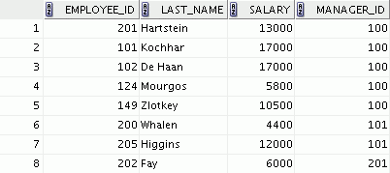
Using the IN Operator
Use the IN operator to test for values in a list:
SELECT employee_id, last_name, salary, manager_id FROM employees
WHERE manager_id IN (100, 101, 201) ;

Slide 12
Pattern Matching Using the LIKE Operator
Use the LIKE operator to perform wildcard searches of valid search string values.
Search conditions can contain either literal characters or numbers:
SELECT FROM WHERE
first_name employees
first_name LIKE 'S%' ;

Slide 13

Combining Wildcard Characters
You can combine the two wildcard characters (%, _) with literal characters for pattern matching:
SELECT last_name FROM employees
WHERE last_name | LIKE '_o%' | ;

Slide 14

Using the NULL Conditions
Test for nulls with the IS NULL operator.
SELECT last_name, manager_id FROM employees
WHERE ;
manager_id IS NULL

Slide 15
Defining Conditions Using the Logical Operators
Operator | Meaning
AND | Returns TRUE if both component conditions are true
OR | Returns TRUE if either component condition is true
NOT | Returns TRUE if the condition is false

Slide 16

Using the AND Operator
AND requires both the component conditions to be true:
SELECT employee_id, last_name, job_id, salary FROM employees
WHERE
AND ;
salary >= 10000
job_id LIKE '%MAN%'

Slide 17
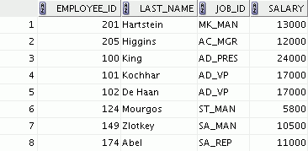
Using the OR Operator
OR requires either component condition to be true:
SELECT employee_id, last_name, job_id, salary FROM employees
WHERE
OR ;
salary >= 10000
job_id LIKE '%MAN%'

Slide 18
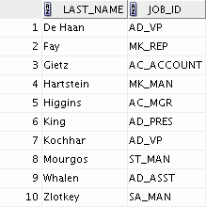
Using the NOT Operator
SELECT last_name, job_id
FROM WHERE
employees job_id
NOT IN ('IT_PROG', 'ST_CLERK', 'SA_REP') ;

Slide 19
Rules of Precedence
Operator | Meaning
1 | Arithmetic operators
2 | Concatenation operator
3 | Comparison conditions
4 | IS [NOT] NULL, LIKE, [NOT] IN
5 | [NOT] BETWEEN
6 | Not equal to
7 | NOT logical condition
8 | AND logical condition
9 | OR logical condition
You can use parentheses to override rules of precedence.
Notes:
Parentheses
* /
+ -
= <> < > <= >=
IS (IS NULL, IS NOT NULL)
BETWEEN
NOT
AND
OR

Slide 20
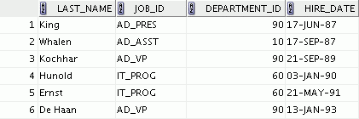
Using the ORDER BY Clause
Sort the retrieved rows with the ORDER BY clause:
ASC: Ascending order, default
DESC: Descending order
The ORDER BY clause comes last in the SELECT
statement:
SELECT last_name, job_id, department_id, hire_date FROM employees
ORDER BY hire_date | ;
…

Slide 21
Sorting
Sorting in descending order:
SELECT FROM
last_name, job_id, department_id, hire_date employees
1
ORDER BY hire_date
DESC
;
Sorting by column alias:
SELECT employee_id, last_name, salary*12 annsal FROM employees
2
ORDER BY
annsal
;

Slide 22
Sorting
Sorting by using the column’s numeric position:
SELECT FROM ORDER BY
last_name, job_id, department_id, hire_date
employees
3
3;
Sorting by multiple columns:
SELECT last_name, department_id, salary FROM employees
4
ORDER BY department_id, salary DESC;

Slide 23




Substitution Variables
... salary = ? …
… department_id = ? …
... last_name = ? ...
I want to query different values.

Slide 24
Substitution Variables
Use substitution variables to:
Temporarily store values with single-ampersand (&)
Use substitution variables to supplement the following:
WHERE conditions
ORDER BY clauses
Column expressions
Table names

Slide 25
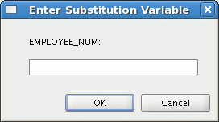
Using the Single-Ampersand Substitution Variable
Use a variable prefixed with an ampersand (&) to prompt the user for a value:
SELECT employee_id, last_name, salary, department_id FROM employees
WHERE employee_id = ;
&employee_num

Slide 26
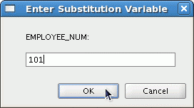
Using the Single-Ampersand Substitution Variable

Slide 27
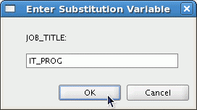

Character and Date Values with Substitution Variables
Use single quotation marks for date and character values:
SELECT last_name, department_id, salary*12 FROM employees
WHERE job_id = '&job_title' ;

Slide 28
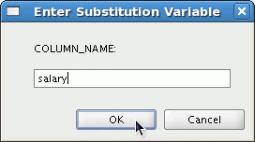
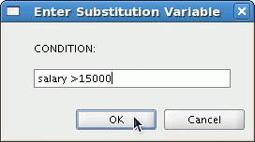
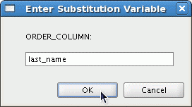
Specifying Column Names, Expressions, and Text
SELECT employee_id, last_name, job_id,&column_name FROM employees WHERE &condition
ORDER BY | &order_column | ;

Slide 29
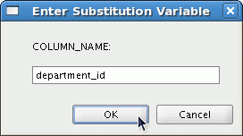

Using the Double-Ampersand Substitution Variable
Use double ampersand (&&) if you want to reuse the variable value without prompting the user each time:
SELECT employee_id, last_name, job_id, FROM employees
ORDER BY ;
&&column_name
&&column_name
…

Slide 30
Using the DEFINE Command
Use the DEFINE command to create and assign a value to a variable.
Use the UNDEFINE command to remove a variable.
DEFINE = 200
employee_num
SELECT employee_id, last_name, salary, department_id FROM employees
WHERE employee_id = ;
&employee_num
UNDEFINE employee_num

Slide 31
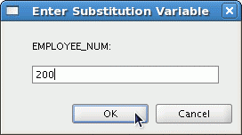
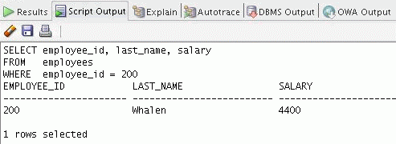
Using the VERIFY Command
Use the VERIFY command to toggle the display of the substitution variable, both before and after SQL Developer replaces substitution variables with values:
SET VERIFY ON
SELECT employee_id, last_name, salary FROM employees WHERE employee_id = &employee_num;

Slide 32
Summary
In this lesson, you should have learned how to:
Use the WHERE clause to restrict rows of output:
Use the comparison conditions
Use the BETWEEN, IN, LIKE, and NULL operators
Apply the logical AND, OR, and NOT operators
Use the ORDER BY clause to sort rows of output:
SELECT FROM
*|{[DISTINCT] column|expression [alias],...}
table
[WHERE condition(s)]
[ORDER BY {column, expr, alias} [ASC|DESC]] ;
Use ampersand substitution to restrict and sort output at run time

Slide 33
Practice 2: Overview
This practice covers the following topics:
Selecting data and changing the order of the rows that are displayed
Restricting rows by using the WHERE clause
Sorting rows by using the ORDER BY clause
Using substitution variables to add flexibility to your SQL SELECT statements

